Slide 1
Sound Effect Devices for Musicians
sdmay20-56.sd.ece.iastate.edu
Dalton Sherratt, Eric Stablein, Zach Besta
Advisor/Client: Dr. Randy Geiger

Slide 2
Some sound effect devices
Synthesizers
Effect pedals
Loopers
Keyboards
Electronic Drum Pads
Samplers

Slide 3
What is a Sampler?
Stores a snippet of audio and plays it when triggered
Some have step sequencers
Can be used to synthesize drum patterns or for even more
Used heavily in rap
Kanye West
Dr. Dre

Slide 4
Problem Statement
Existing sampler apps for Android lack important features and are inaccessible
Hard to understand without or prior knowledge
Missing envelopes, pitch-shifting, etc...

Slide 5
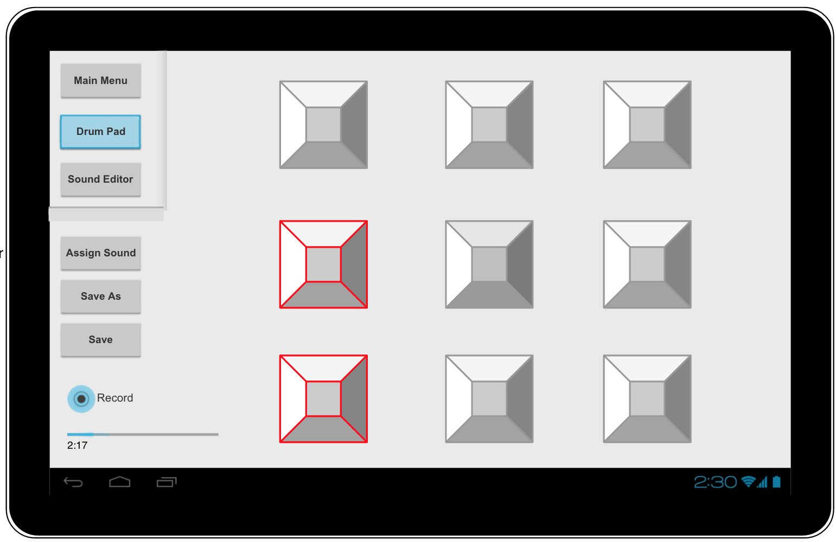
Top-Level GUI

Slide 6
Functional Requirements
The application must be able to run on a fairly modern Android device (API Level 21, Android 5.0 “Lollipop”)
The application must have an easy-to-use, intuitive UI
The application must have a “full” feature set

Slide 7
More functional Requirements
The application must conform to the requirements of the Google Play store
The application needs to have an appealing sound to musicians, both hobbyist and professional
The application must conform to Google’s material design standards

Slide 8
Non-functional requirements
Warn users about hearing damage at high volumes
Make sure users know to take breaks to avoid repetitive stress injuries

Slide 9
Technical/Other Constraints/Considerations
Different processing capabilities between devices
Need to handle legacy devices (API 21)
Screen size difference between devices
Tablet vs phone
Landscape vs portrait

Slide 10
Market survey
iMPC no longer offered
Several simple samplers available
Mainly in “low-end” range (under $2.99)
Samplers with more features are cluttered and unclear
Mainly in “premium” range (over $10)

Slide 11
Market survey examples
App | Price | Functions
nanoloop | $3.49 | Envelope (AD only) Start offset
Pocket Sampler - DJ Launchpad | $2.99 | Online database
iMPC (Apple only) | $6.99 | Time correction Effect modules Recording and overdubbing Step sequencer
G-Stomper Studio | $12.99 | Step sequencer Effect modules Real-time modulation

Slide 12
Potential Risks & Mitigation
Lack of business experience
Hard to judge economic requirements
Limited knowledge of the app marketplace
To mitigate
Monitor economic requirements and extrapolate as new data is obtained
Continually monitor app marketplace

Slide 13
Resource/Cost Estimate
Tentative resources:
Item | Price | Purpose
Lenovo Tab M10 | $100 | Low-end tablet
MPC Studio | $300 | Major physical sampler

Slide 14
Project Milestones & Schedule (1)
Each column represents 1 week

Slide 15
Project Milestones & Schedule (2)

Slide 16
Functional Decomposition
Loading audio from Android file systems
Audio processing tasks
Individual, then merge
Integrate into UI

Slide 17
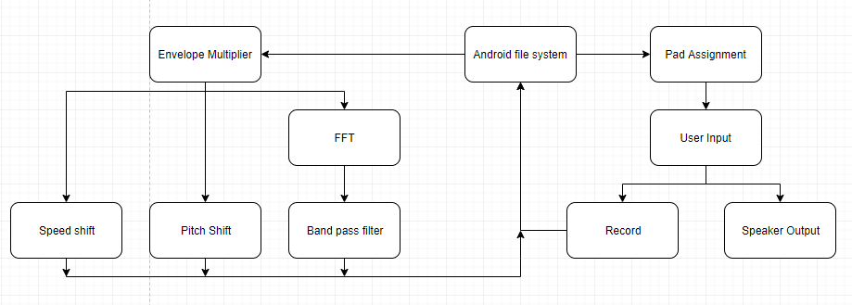
Detailed Design

Slide 18
Detailed Design

Slide 19
Detailed Design

Slide 20
HW/SW/Technology Platform(s) used
Android OS (Lollipop and newer)
Using Android Studio to develop
Personal computers or ISU lab computers
Emulator within Android Studio and personal Android tablets for testing

Slide 21
Test Plan
Tests (Mockito/JUnit) will be implemented by each team member
Test modules individually
Test-first approach
Test modules together
Test user interface
Beta testing with musicians for functionality

Slide 22
Current project status
Design has been planned
Able to move into implementation next semester

Slide 23
Task responsibility/Member contributions
Dalton Sherratt
Create xml files for screenflow and app layout, including equalizer, envelope, and drum-pad screens
Implement interfaces such as the playback interface
Implement classes to write to/pull from devices memory
Eric Stablein
Create classes for shifting pitch of samples
Create drawing-based equalizer
Zach Besta
Create algorithm that shifts speed of samples
Create classes for applying envelopes to samples
Work on drawing-based equalizer

Slide 24
Useful Links
Project folder (requires an Iowa State University login):
https://drive.google.com/drive/folders/1J6CoUSB8kGlspMl5Rx_ZoIqqcnhsiKBc?usp=sharing
Git repository:
https://git.ece.iastate.edu/sd/sdmay20-56
Team website:
http://sdmay20-56.sd.ece.iastate.edu

